Slide 1
Advanced Joins

Slide 2
Classic Models
Download the classicmodels zip and extract it
Each csv is a separate table from the entity relationship diagram on the following slide

Slide 3
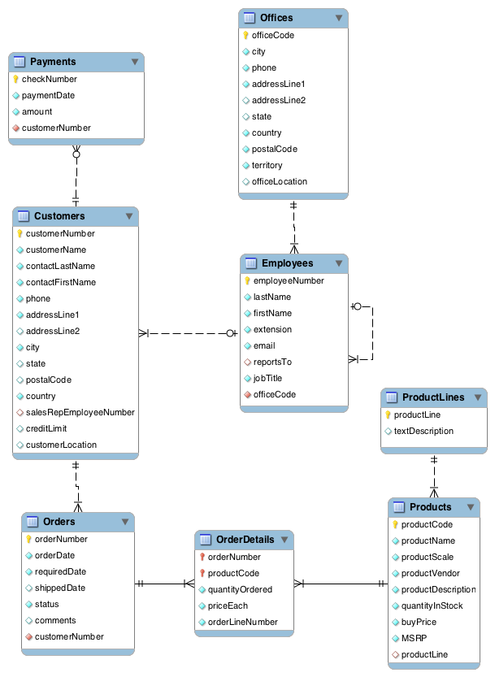

Slide 4
Practice
We’re going to practice breaking down the following questions into subcomponents
Remember, to do any comparisons (filtering, formulas, etc.), you need to have all necessary information on each row
The question is: how can you get all necessary information on each row?

Slide 5
One-to-many practice
Report the account representative for each customer.
Report total payments for Atelier graphique.
Report the products that have not been sold.
List the amount paid by each customer.
How many orders have been placed by Herkku Gifts?

Slide 6
One-to-many practice (2)
Who are the employees in Boston?
Report those payments greater than $100,000. Sort the report so the customer who made the highest payment appears first.
List the value of each 'On Hold' order.
will derive value from OrderDetails : quantityOrdered * priceEach
Report the number of orders 'On Hold' for each customer.
List the status of all orders with a value greater than twice the average of all orders
tables: orders, orderdetails

Slide 7
Many-to-many practice
List names of products sold, sorted by order date.
List the order dates in descending order for orders for the 1940 Ford Pickup Truck.
List the names of customers and their corresponding order number where a particular order from that customer has a value greater than $25,000?

Slide 8
Many-to-many practice (2)
How many orders has each product appeared in? Name the product.
List the names of products ever sold at less than 80% of the MSRP.
Reports those products that have been sold with a markup of 100% or more (i.e., the priceEach is at least twice the buyPrice)

Slide 9
General Queries
Who reports to William Patterson?
List all the products purchased by Herkku Gifts.
For orders containing more than two products, report those products that constitute more than 50% of the value of the order.
What is the value of each product in inventory as a percentage of relative total inventory value, sorted by the highest percentage first.

Slide 10
General Queries (2)
Report for each product, the percentage value of its stock on hand as a percentage of the stock on hand for the product line to which it belongs. Order the report by product line and percentage value within product line descending. Show percentages with two decimal places (i.e., 25.24%).
Find the products sold in 2003 but not 2004.
Find the products sold in a January of any year not sold in a April of any year.
Find the customers without payments in 2003.

Slide 11
General Queries (3)
Compute the revenue generated by each sales representative based on the orders from the customers they serve.

